Slide 1
A Few Points
Hossein abdoh tabrizi
June 6, 2015
www.finance.ir

Slide 2
Macroeconomic environment of iran
Current stagflation situation in Iran
High inflation rate and high volatility
Low GDP per capita growth
High amount of money supply
High unemployment rate
Capital market inefficiency

Slide 3
Productivity and capital inputs in the cake of CAPITAL FORMATION
Current share of Capital is too high
The missing part of the cake is productivity

Slide 4
GDP

Slide 5
GDP per capita

Slide 6
inflation
Average inflation rate: 19.55 %
Single Digit Inflation Rate: 2 Years
Two Digit Inflation Rate: 34 Years
Inflation Rate over 20 Percent: 17 Years
Inflation Rate over 30 Percent: 3 Years
Highest Inflation Rate: 49.4 Percent (1995)
Lowest Inflation Rate: 6.9 Percent (1985)

Slide 7
challenges
High unemployment rate
Lower family budgets
To keep unemployment rate at its current level, we need a growth rate of 6%
Major engine of economic growth during last Government: “capital factor” Capital stock and economic growth went hand in hand
Even with revenues similar to Ahmadinejad’s Government, the growth rate would have dropped to 2%-3% corridor
Major demographic changes

Slide 8
Labor market
Reduction of Labor Participation Rate
3.5 million unemployed
Major difference of male & female unemployment rates
Major difference of unemployment rates across age groups
4.5 million students: the army of unemployed
Average Unemployment Rate: 11.94%
Highest Unemployment Rate: 14.3% (2000)
Lowest Unemployment Rate: 9.1% (1996)

Slide 9
Major Demographic Changes

Slide 10
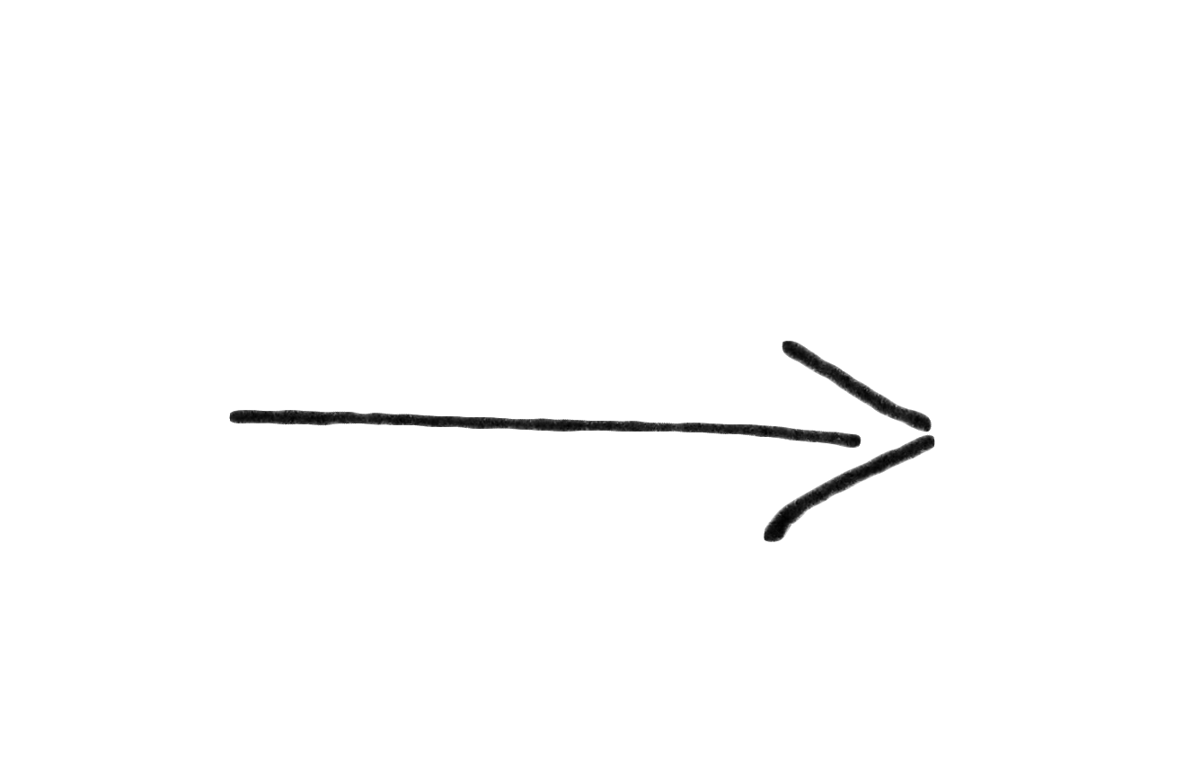
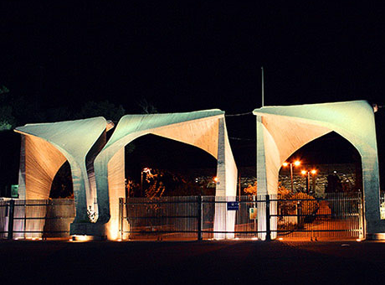
THE ROLE OF PRODUCTIVITY
Productivity
Training
Education
Startups
VCs

Slide 11
Iranian banks’ current situation
Large amount of doubtful and bad debts
Low liquidity problems
Lack of secondary markets for banks’ assets
Investing in real state

Slide 12
VC’s Can not rely on troubled Banks:
Banks are so deep in trouble that can not help VC’s at this stage

Slide 13
Domestic credit to private sector

Slide 14
Domestic credit to private sector

Slide 15
Asset and equity of Iranian banks

Slide 16
Real growth of banks’ assets

Slide 17
Growth of Doubtful and Bad Debts

Slide 18
Growth of Doubtful and Bad Debts

Slide 19
A Few Points about Solutions

Slide 20
Major Obstacles Mentioned
Poor implementation of regulations & laws (weak judicial system/corruption)
No proximity to other successful ventures (no Silicon Valley effect)
Unavailability of talented human resources
Cultural issues dissuading individuals from entrepreneurship
Poor linkages & unavailability of quality educational institutions
Financial institutions not keen on supporting technology related ventures

Slide 21
Major Problems with Iranian Startup Industry
Project-Based rather than Fund (Company) Based
Suede-Governmental structures
Mostly financing seed-stage research
Concentrated on R&D, forgetting economic success side
Established funds are not VC’s

Slide 22
Major Problems with Iranian Startup Industry II
Limited capital base
Less financial intermediation
So many universities playing stockholder role
Missing institutions in Iranian Startup Ecosystem
Iranian Judicial System cannot support intellectual properties

Slide 23
Lack of seed and early stage angle investors
Mainly because of:
High disequilibrium interest rate
Illusive real estate market
Ample opportunities yet to invest in real assets
Informal money market for trade dealers
Gold and Exchange deals due to sanctions
Day trading in the Exchange by the youth

Slide 24
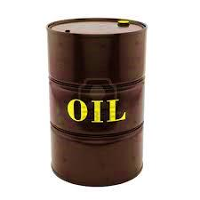
Energy consumption
Cheap subsidized energy ended to high consumption rate, and low productivity of industries
Startups have huge potentials in energy saving fields
700 million barrels in a year
×
60 Dollars
162.2 billion m³ in a year
×
50 cents
123 billion dollars

Slide 25
Insignificant tiny miniature risk of imported and market tested concepts and ideas
Do we really have VC in developing countries?

Slide 26
Financial sanctions
“I still don’t know how to put my money into a project in Iran”
Sanctions, Disengagement with Iran, Isolation, and financial sanctions in particular

Slide 27
Too Many Problems
So Many Obstacles
Yet, Such a Huge Arena of Opportunities

